Slide 1
EFM Challenge
Mike Hughey, MD

Slide 2
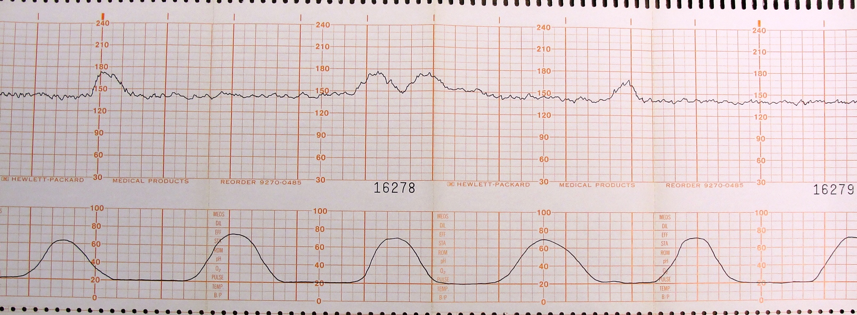
EFM #1
Contractions
Baseline
Decels/Accels
Category

Slide 3
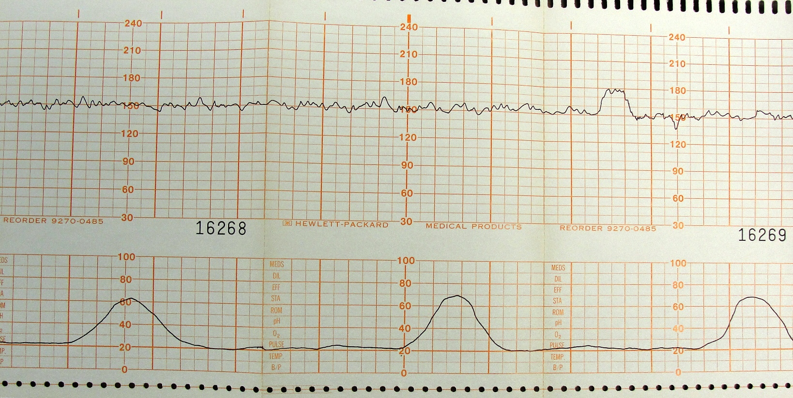
EFM #2
Contractions
Baseline
Decels/Accels
Category

Slide 4
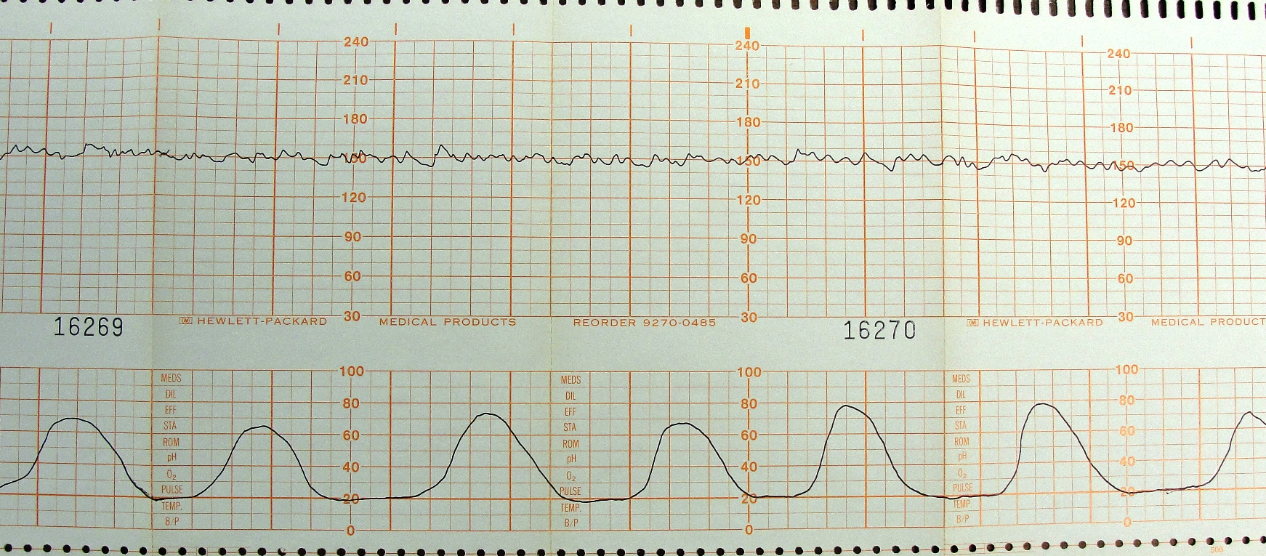
EFM #3
Contractions
Baseline
Decels/Accels
Category

Slide 5
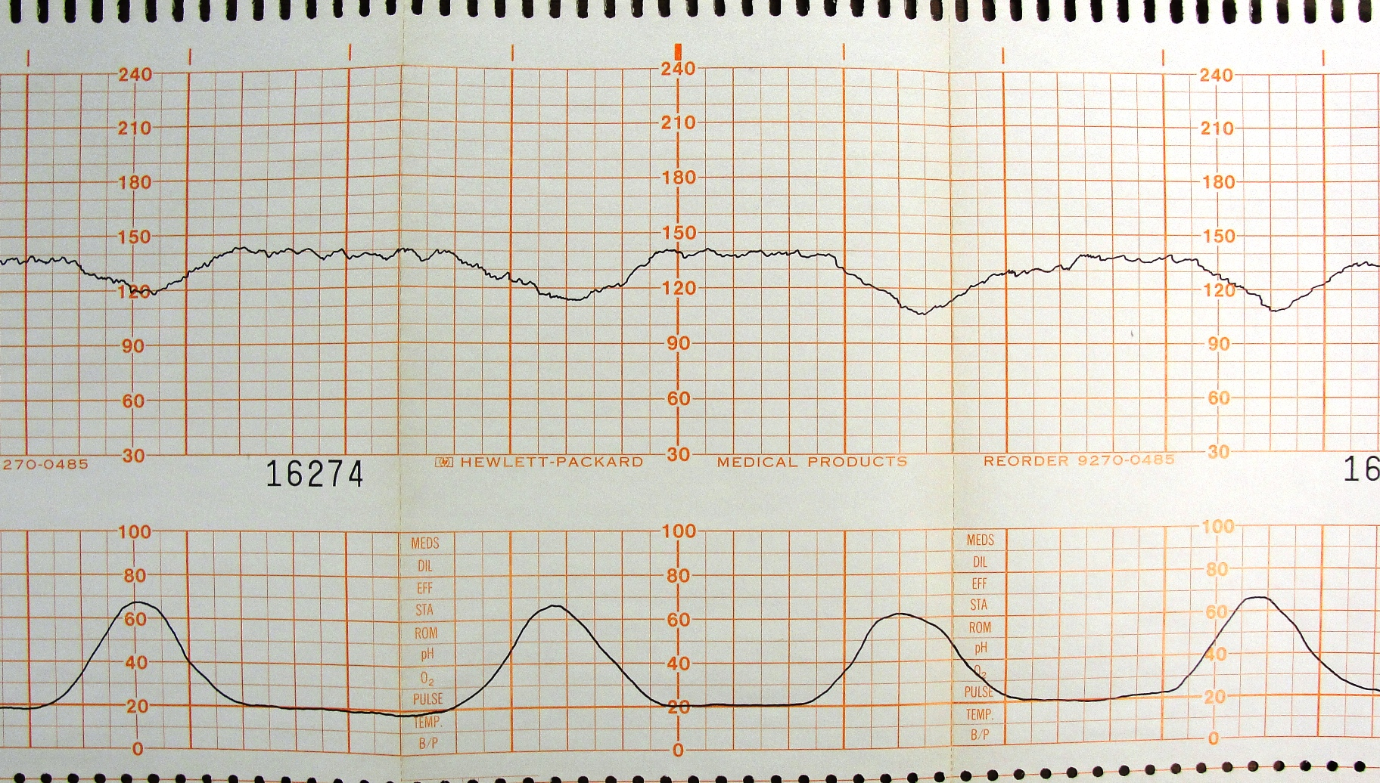
EFM #4
Contractions
Baseline
Decels/Accels
Category

Slide 6
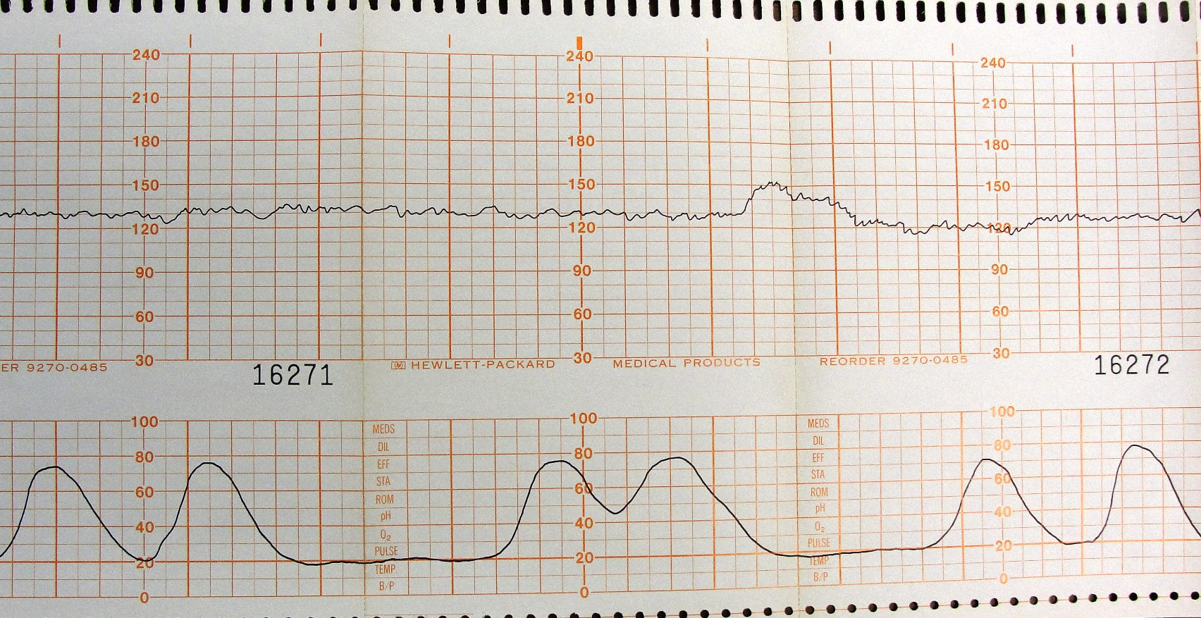
EFM #5
Contractions
Baseline
Decels/Accels
Category

Slide 7
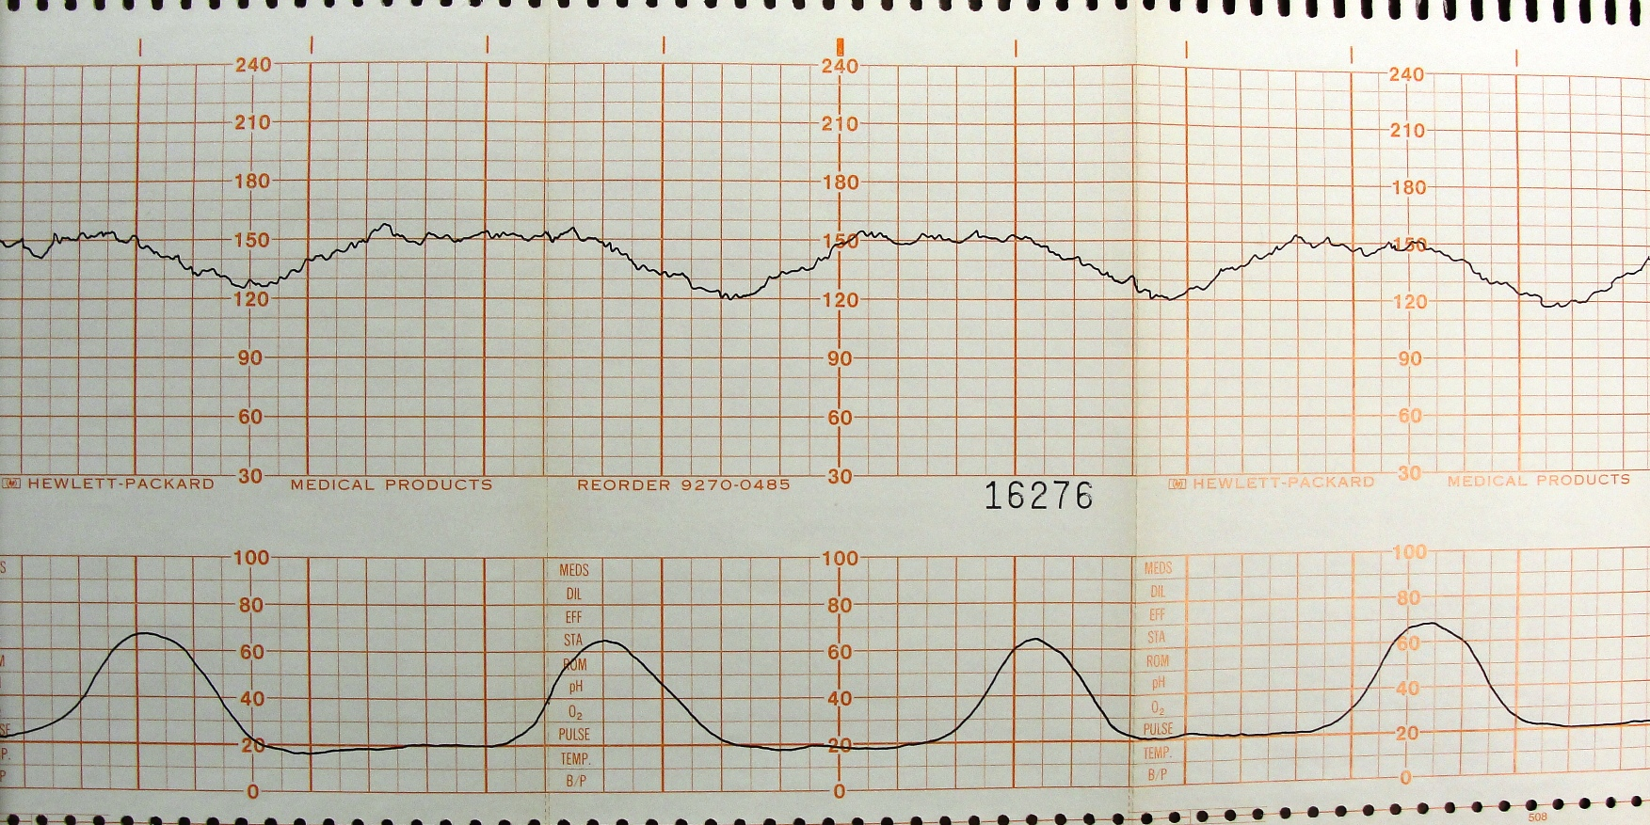
EFM #6
Contractions
Baseline
Decels/Accels
Category

Slide 8
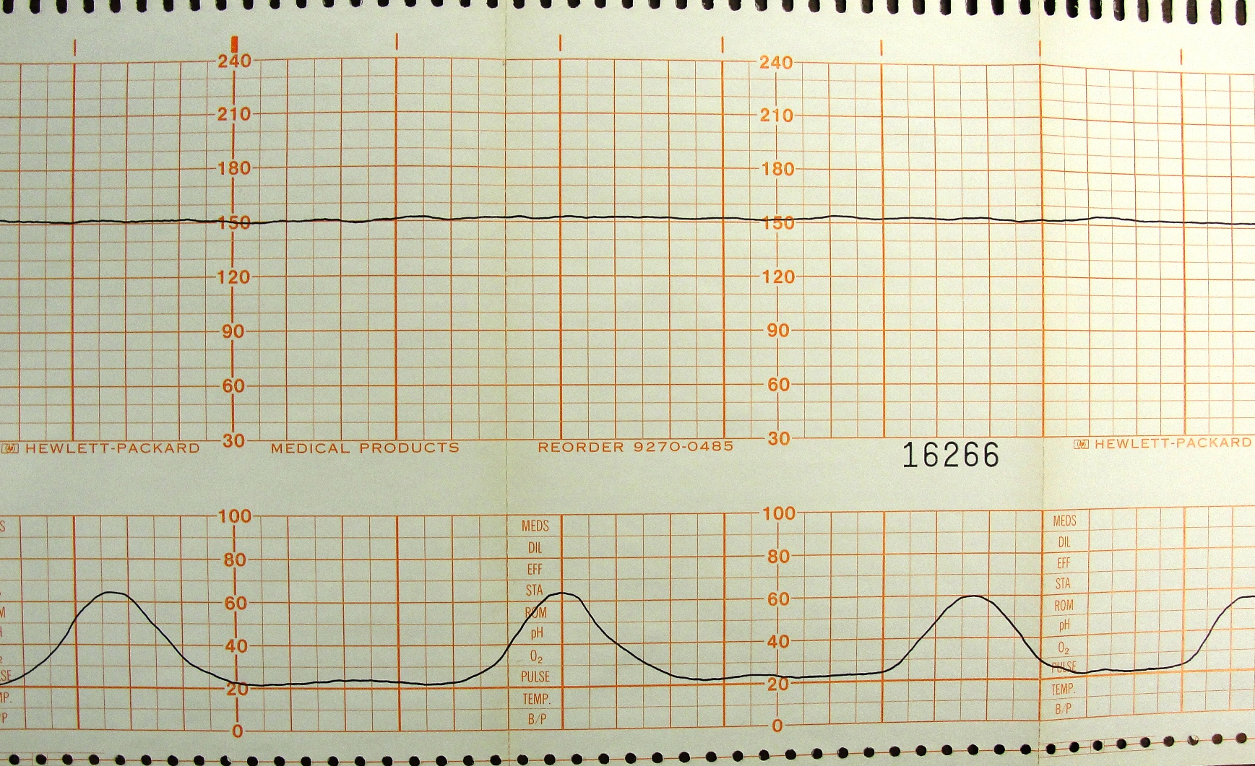
EFM #7
Contractions
Baseline
Decels/Accels
Category

Slide 9
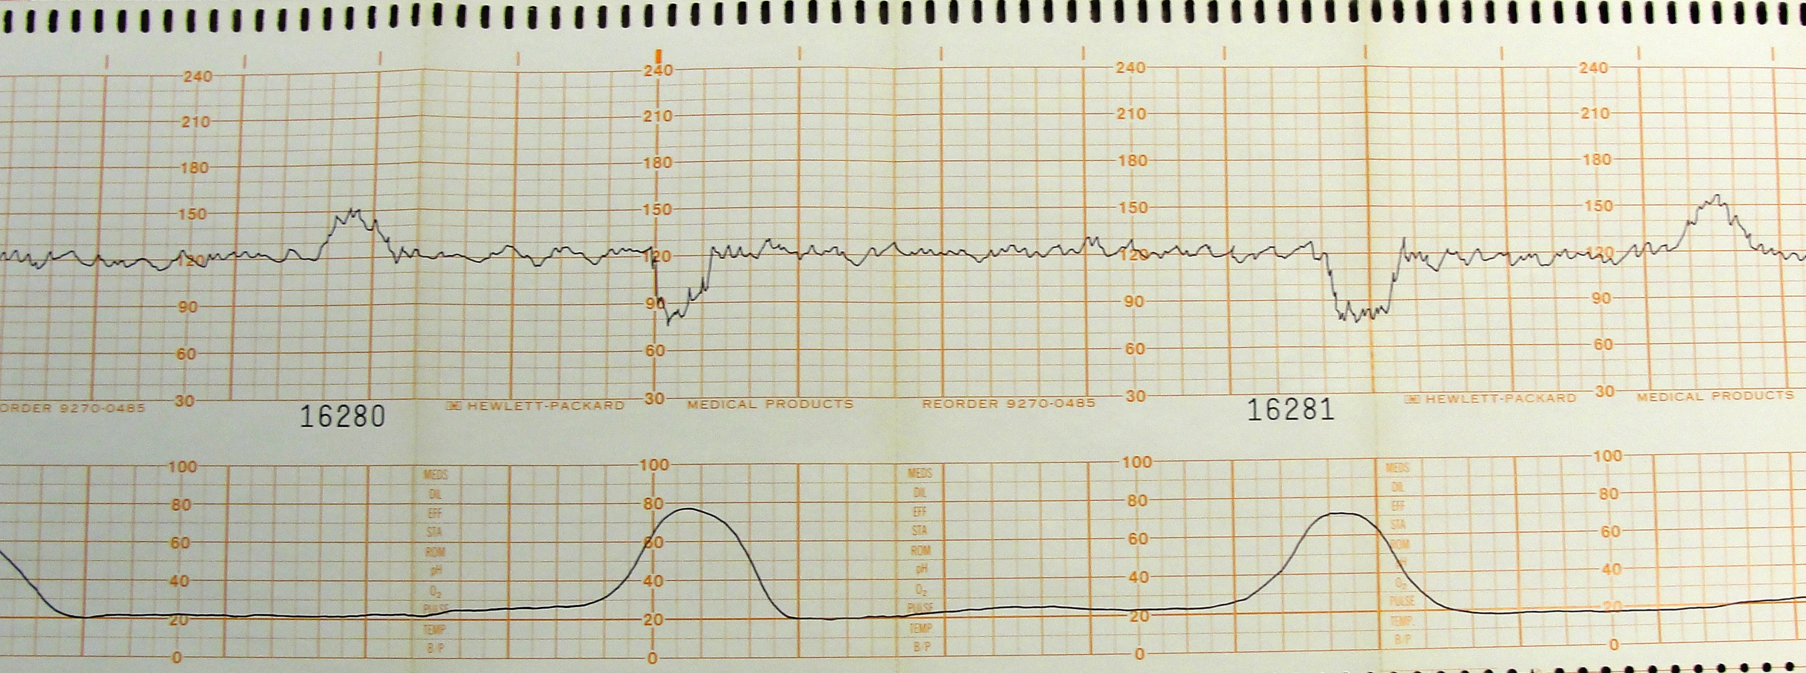
EFM #8
Contractions
Baseline
Decels/Accels
Category

Slide 10
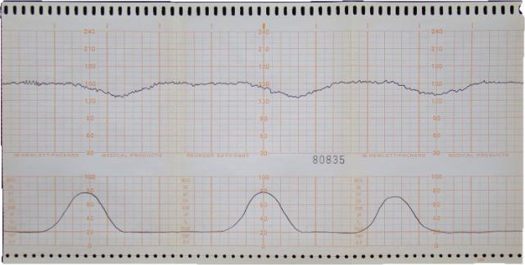
EFM #9
Contractions
Baseline
Decels/Accels
Category

Slide 11
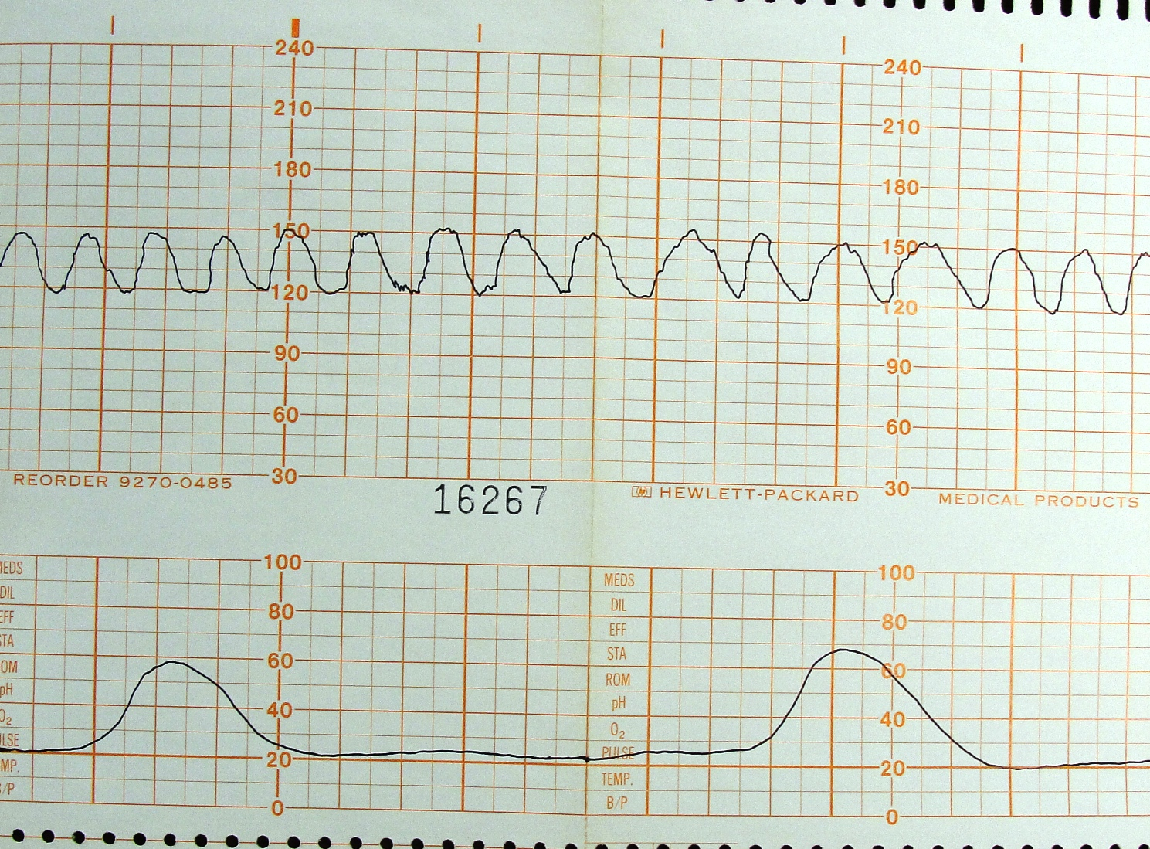
EFM #10
Contractions
Baseline
Decels/Accels
Category

Slide 12
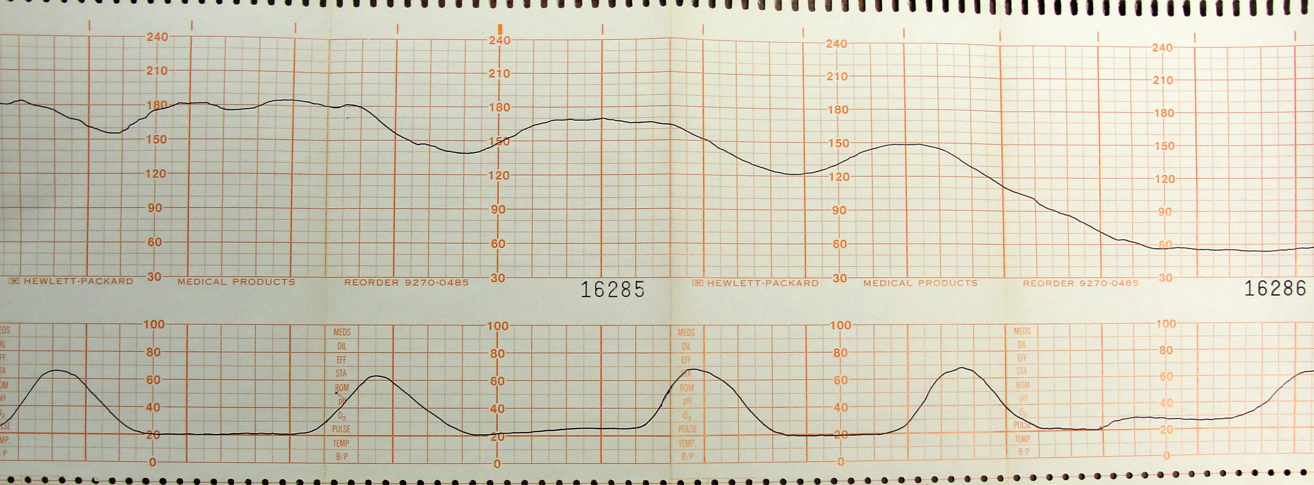
EFM #11
Contractions
Baseline
Decels/Accels
Category

Slide 13
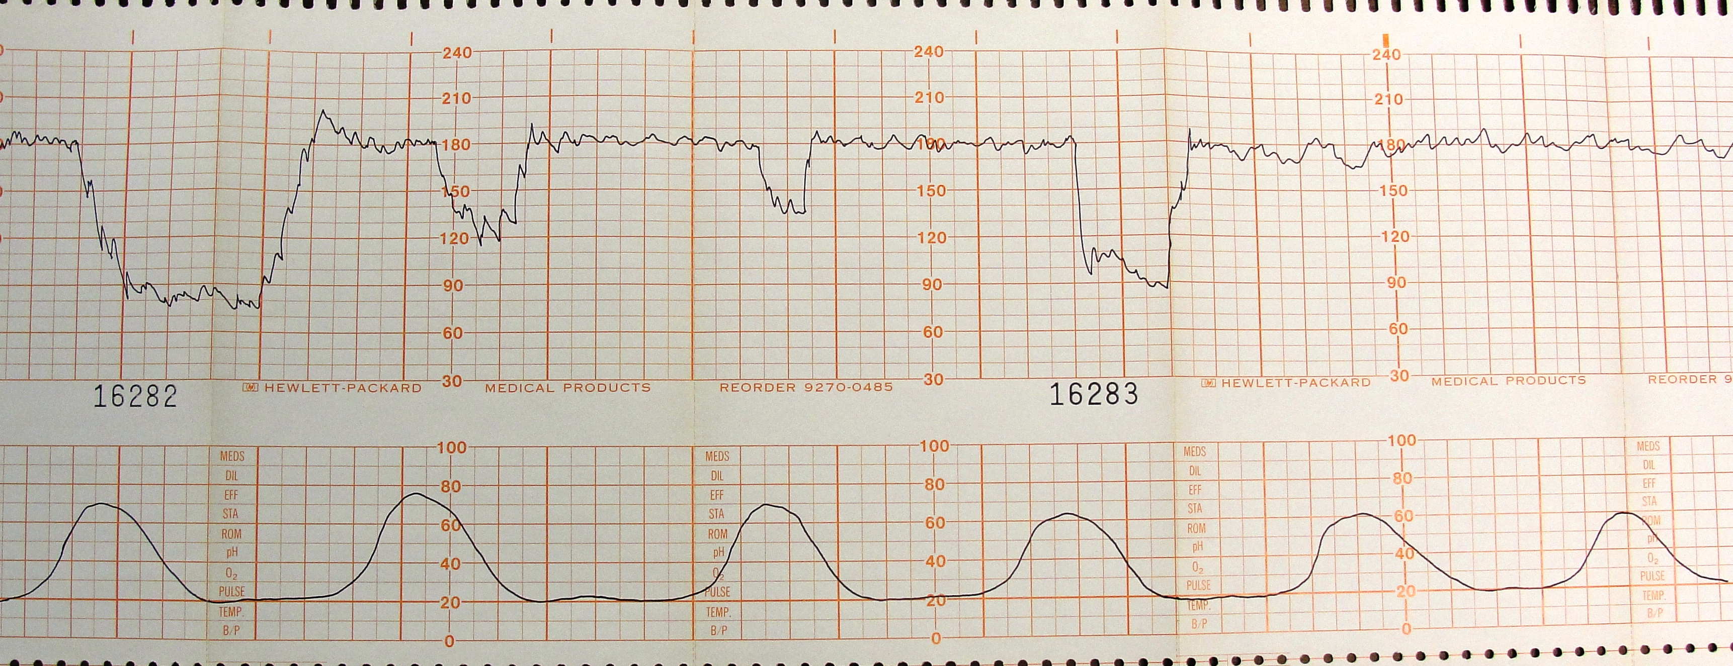
EFM #12
Contractions
Baseline
Decels/Accels
Category

Slide 14
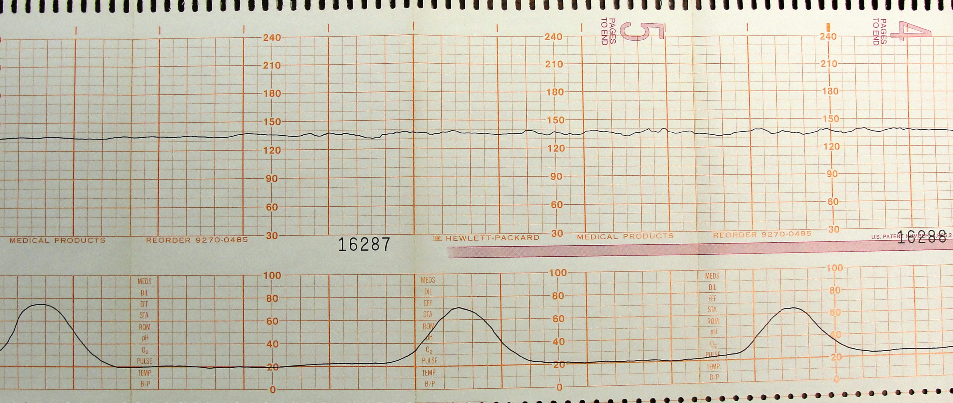
EFM #13
Contractions
Baseline
Decels/Accels
Category

